Slide 1
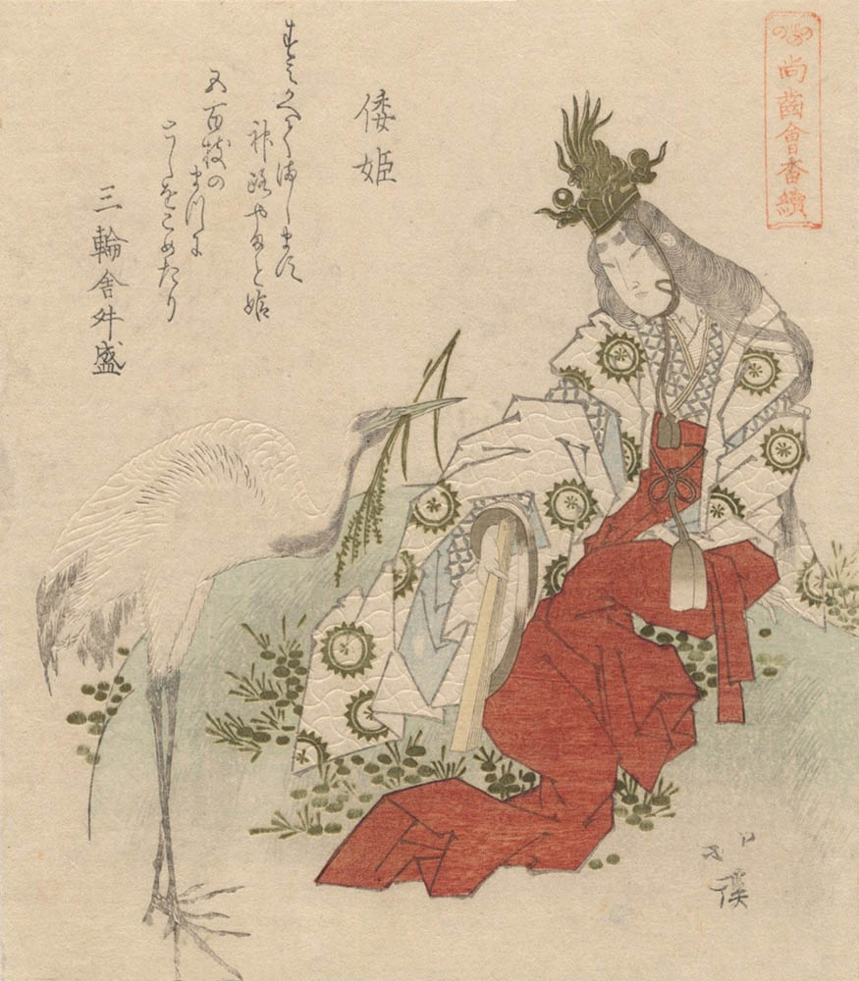
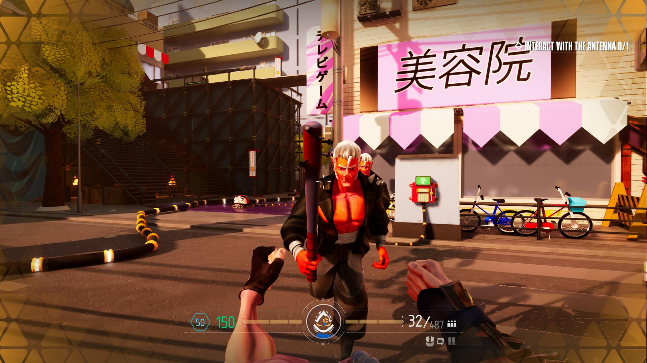
Yamatohime Sacred Quest
Lore:
You are playing as Princess Yamatohime-no-Mikoto defending and rebuilding an abandoned shrine from waves of evil yokai using the legendary Kusanagi no Tsurugi and divine powers granted to her by Amaterasu Ōmikami (goddess of the Sun).
Why I believe It’s a good Starting Point:
Focused on a single map, modular enemy waves, and scalable abilities is the scope of the project, and I would believe that it will fit semester timeline.
Gameplay:
My proposed gameplay is a round-based first-person action game where players are to defend an abandoned sacred shrine from yokai. The area will be in the yard of the shrine where evil yokai will spawn on the edge of the map and work themselves inwards towards the shrine.
Yamatohime-no-Mikoto
Sample of the ideal game play
Key Features:
First-person combat.
Waves of diverse evil yokai enemies with increasing difficulty per round.
Gifting buffs from Benevolent Yokai granting unique abilities.
Unlockable divine flame powers from goddess Amaterasu Ōmikami

